Slide 1

EE-371 : Control Systems
Lecture#39
Time Domain Analysis
3.4 Applying the State-Space Representation 118
Design via State Space
12.1 Introduction
12.2 Controller Design
Topology for Pole Placement
Pole Placement for Plants in Phase-Variable Form
Textbook: Chapter # 12 (5th edition)
Text Book: Control Systems Engineering by Norman S. Nise 5th Edition
Instructor: Ms Neelma Naz
Class: BEE 12 C/D
School of Electrical Engineering and Computer Science
Department of Electrical Engineering

Slide 2
Converting from State Space to a Transfer Function

Slide 3
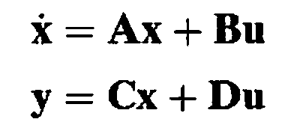

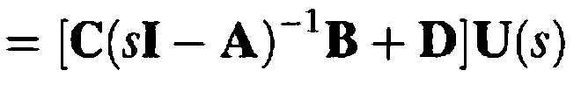
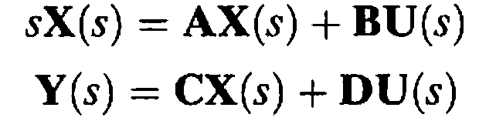

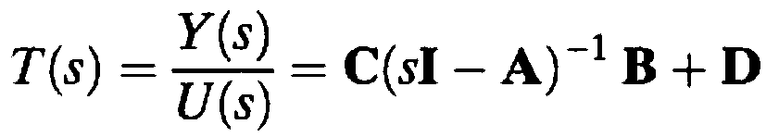

The state and output equations are given as
Substituting for X(s) in Eq (2)
Taking the Laplace transform assuming zero initial conditions
(1)
(2)
Transfer function matrix
From Eq (1)
If U(s) = U(s) and Y(s) = Y(s) are scalars, the transfer function can be found

Slide 4
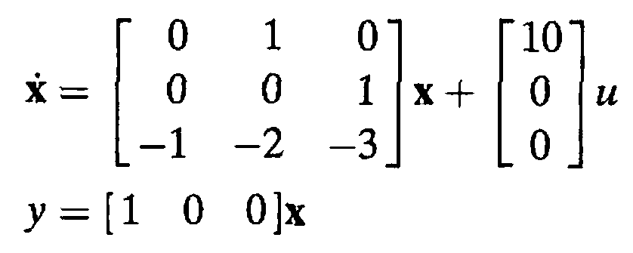

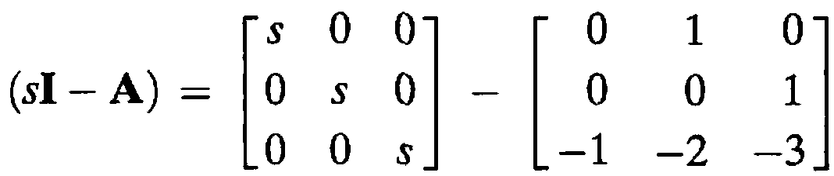
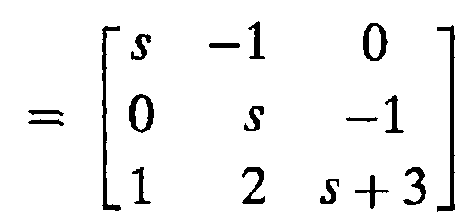
Example 3.6
State-Space Representation to Transfer Function
PROBLEM: Given the system defined by the following state and output Equations, find the transfer function, T(s) = Y(s)/U(s), where U(s) is the input and Y(s) is the output.
SOLUTION:
The transfer function matrix is:

Slide 5

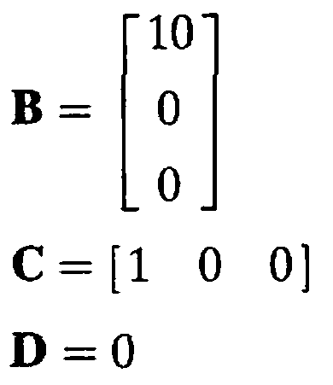
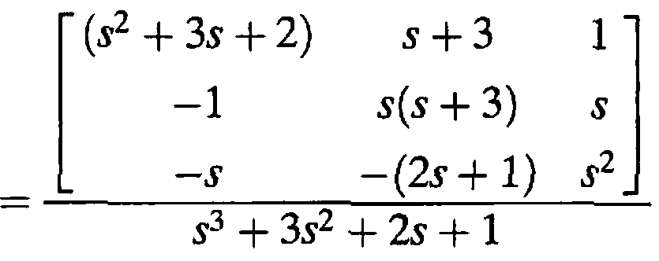
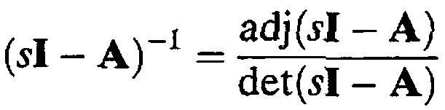
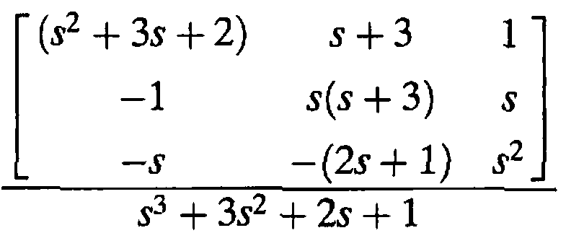
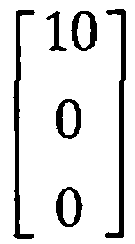

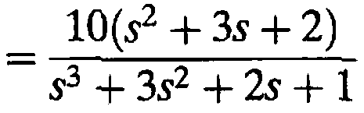

Slide 6
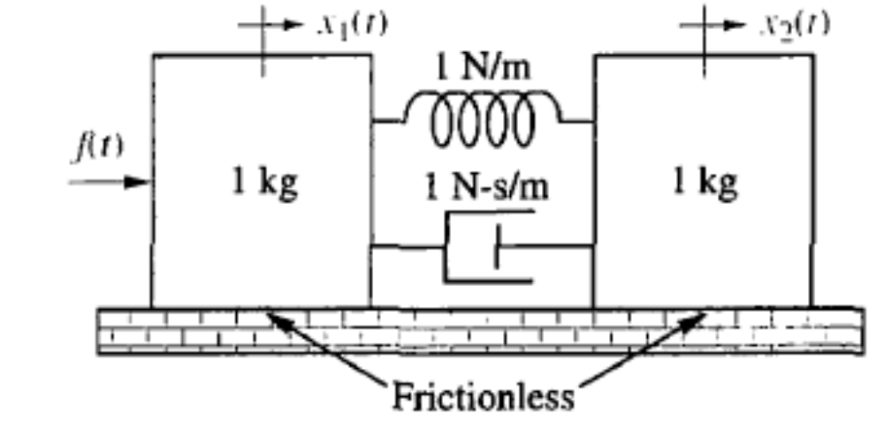
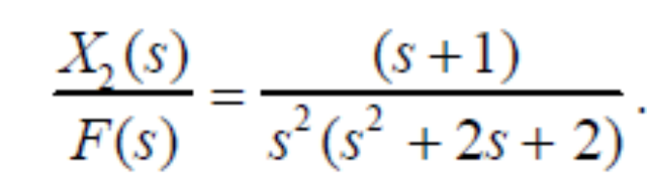
Home Assignment
Convert the given transfer function for the mechanical translational system to the state-space representation in phase-variable form.
Draw equivalent block diagram showing the phase variables.

Slide 7
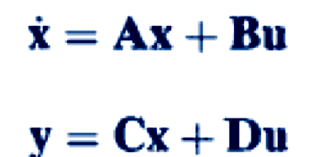


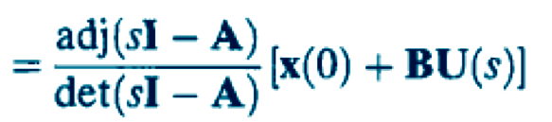


4.10: Laplace Transform Solution of State Equations
State equations
Output equations

Slide 8
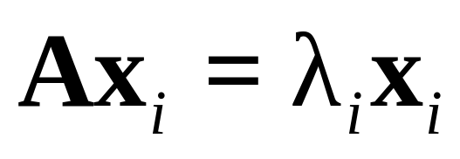
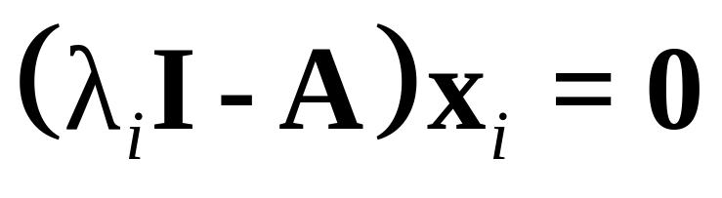

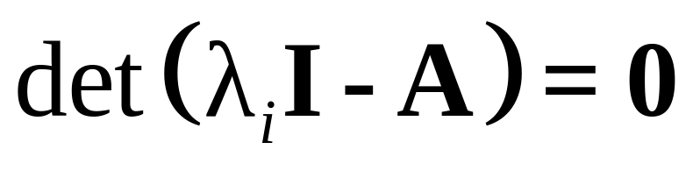
Eigen values and Transfer Function Poles
a nonzero solution exists if
The eigenvalues, λ_{i}, of matrix A can be found by solving the polynomial

Slide 9
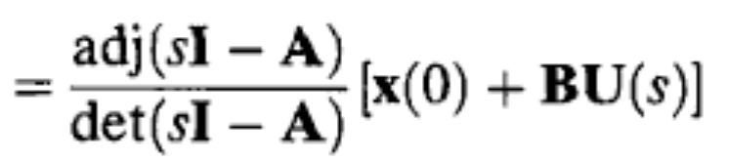
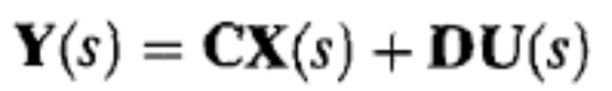
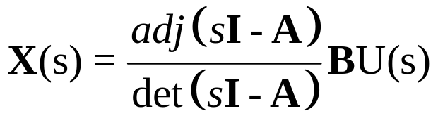

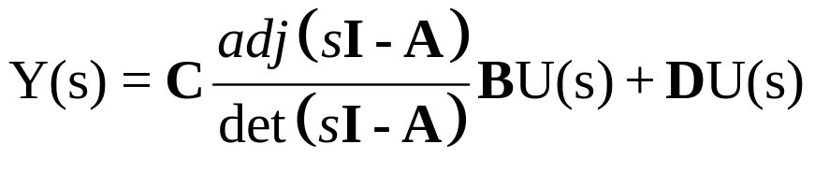
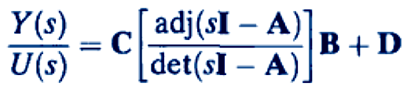
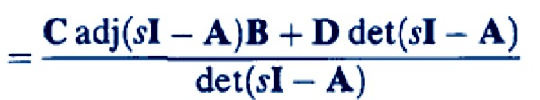
Let the output, Y(s), and the input, U(s), be scalar quantities Y(s)
and U(s), and the initial state vector x(0) is equal to 0
The roots of the denominator are the poles of the system

Slide 10
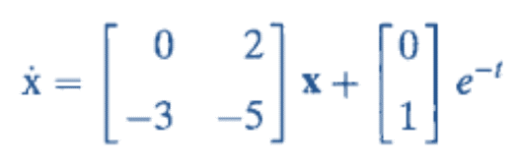
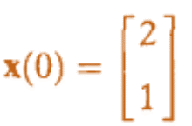
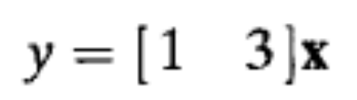
Exercise 4.9
PROBLEM: Given the system represented in state space by
Do the following:
a. Solve for y(t) using state-space and Laplace transform techniques.
b. Find the eigenvalues and the system poles.

Slide 11
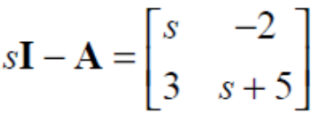
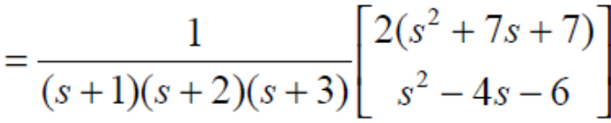
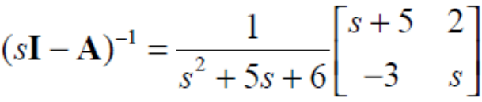
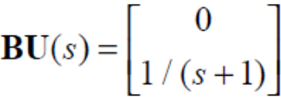
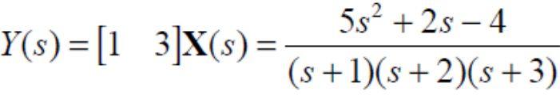
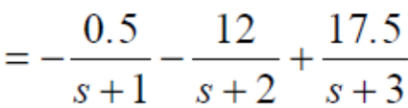




Solution
a.
b.

Slide 12
Design via State Space

Slide 13
Introduction
Frequency domain Design
Controller is designed to place the dominant second-order pair of poles
Effect of higher-order poles on the second-order approximation ???
Desirable
Specify/place all closed-loop poles of the higher-order system
Limitations of Frequency Domain Methods
Do not allow to place all of the closed-loop poles distinctively
One gain to adjust, or compensator pole and zero to select, does not yield a sufficient number of parameters to place all the closed-loop poles at desired locations
To place n unknown quantities,
n adjustable parameters are required

Slide 14
Introduction
State-space methods solve the problem by introducing into the system
Requisite adjustable parameters
Technique for finding values of these parameter, so that all poles of the closed-loop system can be properly placed

Slide 15
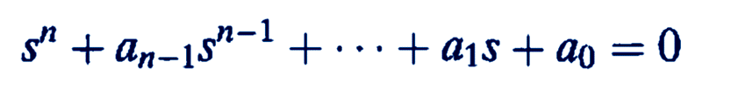
Controller Design
An nth-order feedback control system has an nth-order closed-loop characteristic equation of the form
There are n coefficients whose values determine the system's closed-loop pole locations
We need to introduce n adjustable parameters and relate them to the coefficients to place the poles as per design requirement

Slide 16
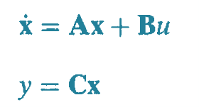
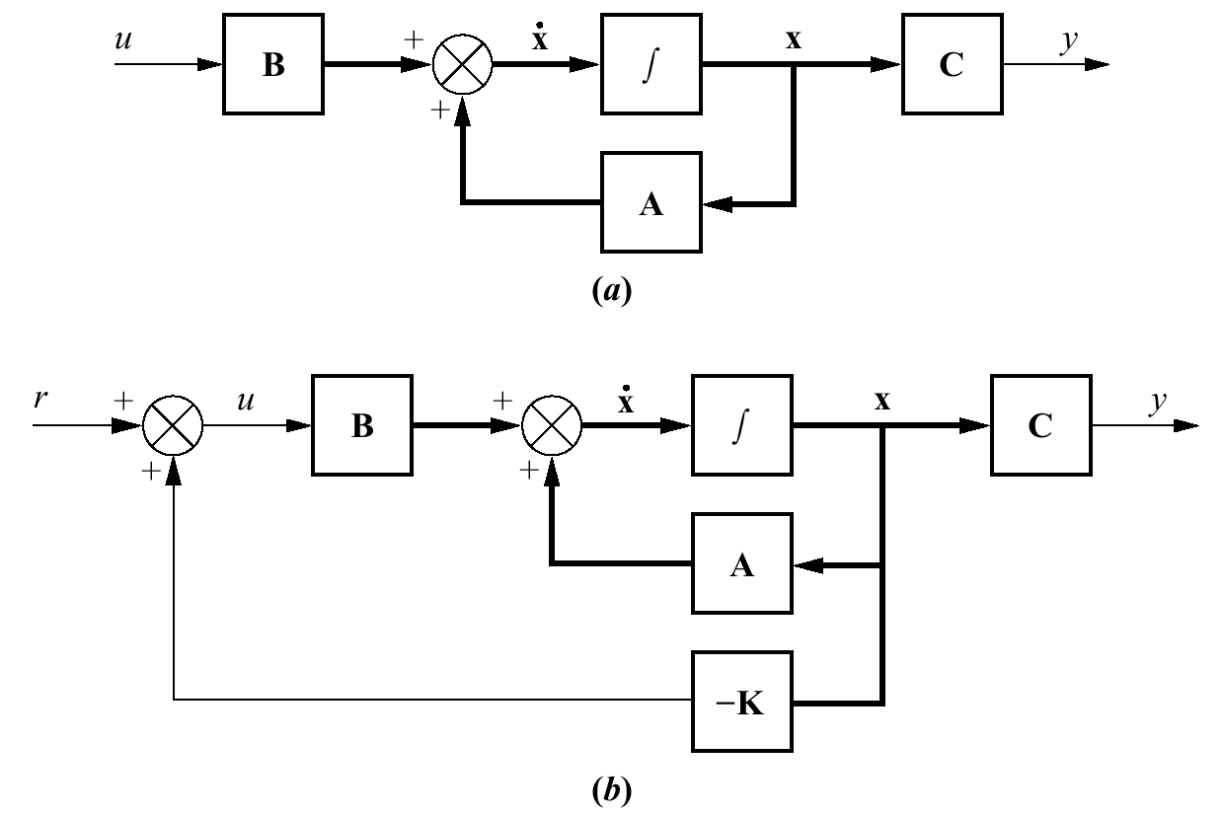





Topology for Pole Placement
State feedback instead of
output feedback
If each state variable is fed back to the control, u, through a gain, k_{i} ,there would be n gains, k_{i} , that could be adjusted to yield the required closed-loop pole values
r
-K

Slide 17
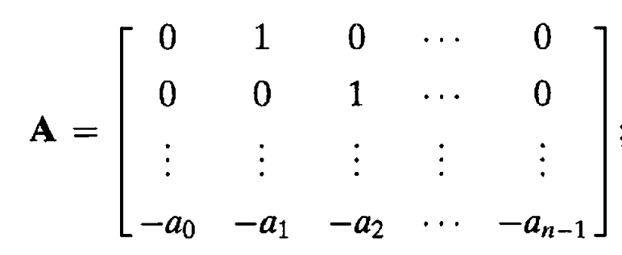
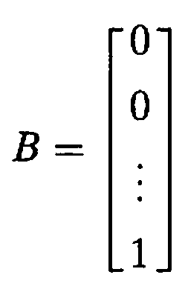



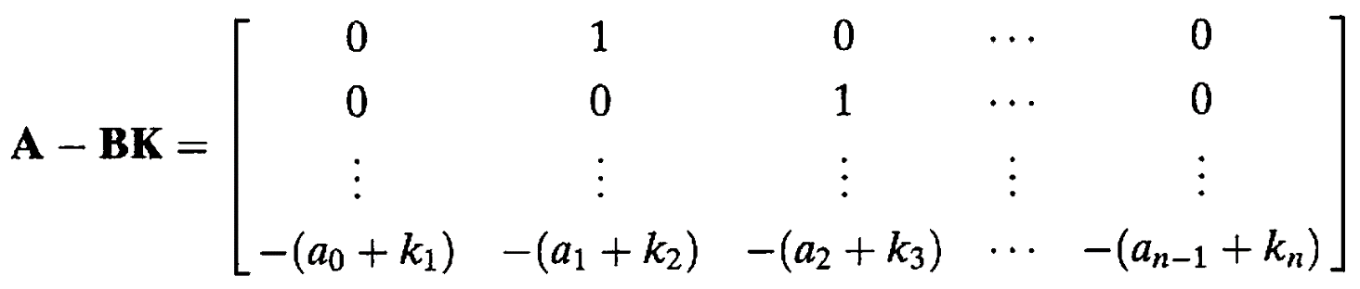
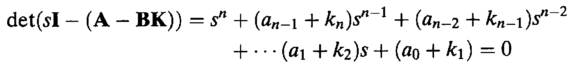

Slide 18


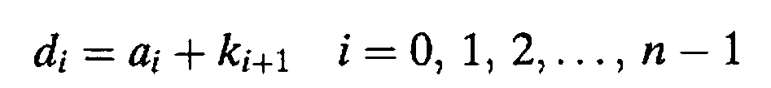
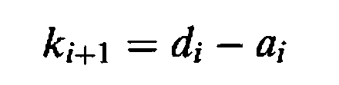
Open-loop characteristic equation
Closed-loop characteristic equation
Desired characteristic equation
Equating coefficients to find the gains

Slide 19
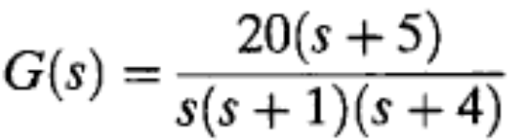

Example 12.1
PROBLEM: Given the plant
design the phase-variable feedback gains to yield 9.5% overshoot and a settling time of 0.74 second.
SOLUTION:
From the transient response requirements, the desired closed-loop dominant poles are -5.4 ± j7.2
The closed-loop system zero is at -5
Choose -5.1 as the location of the third closed-loop pole.
Desired closed-loop characteristic equation:

Slide 20
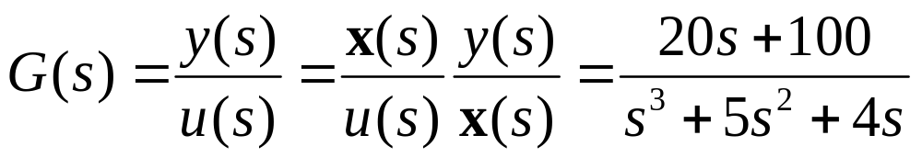
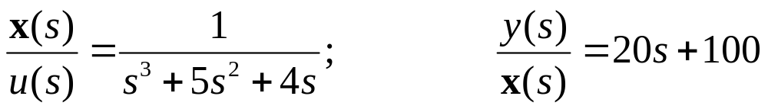
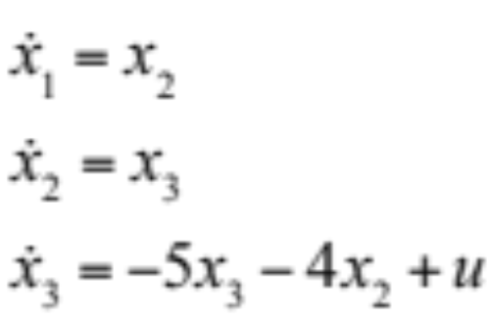
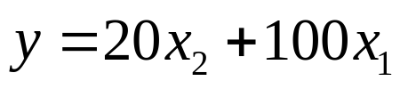
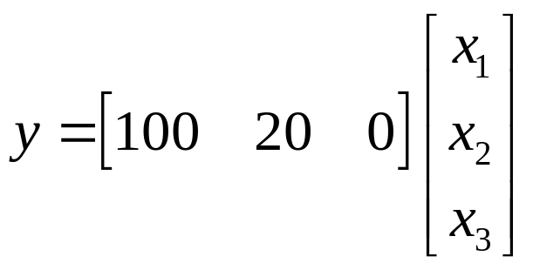




Slide 21



Slide 22



Slide 24


The closed-loop stem's characteristic equation is:
The desired characteristic equation is:
Equating the coefficients we find:
k1 = 413.1; k2 = 132.08; k3 = 10.9

Slide 25



Slide 26

Step response simulation of the closed-loop system
Design specs
Overshoot = 9.5%
settling time = 0.74 sec
Overshoot = 11.5%
Settling time = 0.8 second
Redesign
Steady state error ???

Slide 27

???

